Slide 1
SASPO RAFB Industry Day 2023
Mr. George K. Levy III
638 SCMG/CL DSN – 468-1072 George.Levy@us.af.mil
March 2023
Notes:
Good afternoon.
We would like to welcome you to the 638th Supply Chain Management Group and we will be telling you a little bit about the group.
But first, INTRODUCE MS. HERREN AND MR. FOSKEY and we would to know who you are, so let’s go around the room and introduce yourself, tell us your name, where you work and what you will be doing AND if you have a computer.

Slide 2
Agenda
Welcome
638 SCMG Leadership
Overview
Challenges – Aging Fleets
Squadron Mission Sets
Functional Areas
Supply Chain Challenges & Way Forward

Slide 3
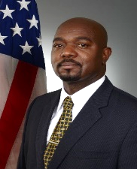
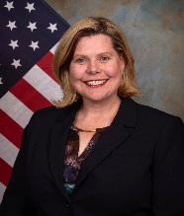
638 SCMG Organization Chart
Mr. George K. Levy III, Director
Ms. Stacia Franks, Deputy Director
Mr. Johnathan Ringley, Director of EN
Management
Operations (OM)
Ms. Elizabeth Garcia (Exec)
Ms. Tawanna Holland (CLE)
Director
Financial
Management (FM)
Jay Harrington
Supply Chain Integrator
Deputy
404 SCMS/CL
Support Equipment & Vehicles
Mr. David Garza
407 SCMS/CL
Common Avionics
Ms. Kristine Griffis
408 SCMS/CL
Electronic Warfare
Mr. Robert Pinkney
409 SCMS/CL
Aircraft Missiles & Armament
Ms. Kristin Howell
410 SCMS/CC
Support Equipment & Automatic Test Systems
Lt Col Donnell Pittman
411 SCMS/CL
Special Ops Forces
Mr. David Yelverton
Business Operations
GUBA
Business Operations
GUBA
Business Operations
GUBA
Business Ops
Armament
GUBA-GUME
Business Operations
GUBA
Business Operations
GUBA
Integration
GULA
Engineering
GUEA
Engineering
GUEA
Engineering
GUEA
Engineering
GUEA
Logistics A
GULA
ATS, Equip, Vehicles & Small Arms
GUMA
Communications
GULA
Airlift/Special Op Forces
GULA
C-5
GUMA
Automatic Test Sys
GULA
Logistics A
GULA
ATS, Equip, Vehicles & Small Arms
GUMA
Navigation
GUMA
Fighter/Bomber
GULB
C-130
GUMB
Support Equip/Vehicles
GULB
Workforce
Civilian: ~760
Military: 9
Contractors: 19
Total: ~788
F-15
GUMC
Group Staff Squadron Flight

Slide 4
638 SCMG Overview
6 Squadrons + Functional Divisions
788 Civilian, Military Personnel and Contractors
Provides global logistics support for over 62K items/NSNs
Plan, Source, and Execute for Repairable Spares DLRs
C-5, C-130, F-15 and RQ-4 peculiar avionics and structural items
Common avionics, EW, SOF platforms and SE&V and ATS DLRs
Reciprocating Relationship with the WR-ALC
Executes ~$1.1BM in acquisition spares, repair and EN projects
Over 250 contracts with private industry
~10 Public Private Partnerships
Corporate Contract oversight: BAE, Collins, NGC, and Raytheon
Facilitates supply chain readiness to enhance combat power for the United States and its International Partners
DLR – Depot Level Reparables NSN – National Stock Number SEV – Support Equipment & Automatic Test Systems

Slide 5
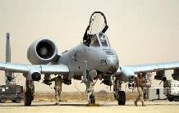
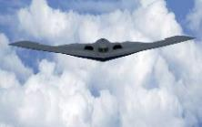
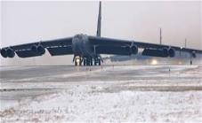
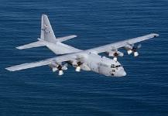
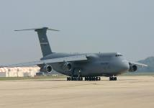
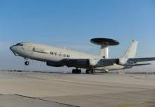
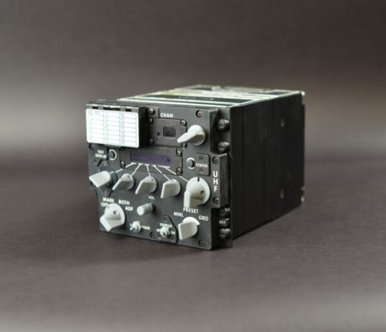
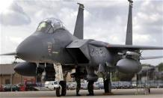
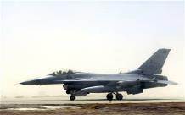
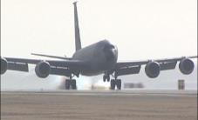
Challenges - Aging Fleets
A-10 – 50 yrs (1972)
B-1B – 49 yrs (1973)
B-2 – 35 yrs (1987)
B-52 – 70 yrs (1952)
C-130 – 68 yrs (1954)
C-5 – 54 yrs (1968)
E-3A – 45 yrs (1977)
Radios – 42 yrs (1981)
5
F-15 – 50 yrs (1972)
F-16 – 49 yrs (1973)
KC-135 – 67 yrs (1955)
GPS – 27 yrs (1995)
As of Jan 2022

Slide 6
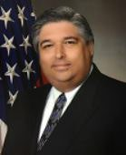
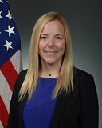
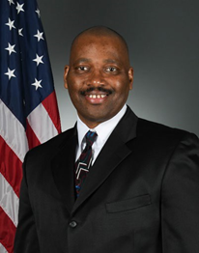
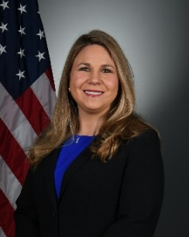
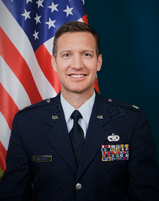
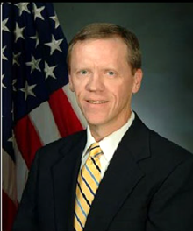
638 SCMG – Mission Sets
404 SCMS
Support Equipment
&
Vehicles
407 SCMS
Common
Avionics
408 SCMS
Electronic
Warfare
409 SCMS
Aircraft
&
Armament
410 SCMS
SE&V
&
ATS DLRs
411 SCMS
Special Operations Forces/Personal Recovery
Mr. David Garza
Ms. Kristine Griffis
Mr. Robert Pinkney
Ms. Kristin Howell
Lt Col Timothy Breitbach
Mr. David Yelverton
Aerospace Ground Equipment (AGE)
Munitions Material Handling Equipment (MMHE)
Base & Aircraft Support Equipment (BASE)
Industrial Plant Equipment (IPE)
Peculiar Support Equipment
Automatic Test Systems/ Equipment (ATS) (ATE)
Mobility and Vehicles
Communications: Airborne Radios, GPS, Data Links, Ground Communications
Precision Attack: LANTIRN, Sniper/Litening, IFF
Navigation: JHMCS, Heads-Up Display, Radars, Instrument and Landing Systems
Command & Control Intelligence, Surveillance, and Reconnaissance (C2ISR)
RQ-4 Global Hawk commodities
Towed Decoys
Infrared Jammers
Radio Frequency Jammers
Missile Warning Systems
Radar Warning Receivers
Chaff & Flare Dispensers
EW Suite Controllers and Test Sets
C-5, C-130 and F-15 aircraft peculiar assets and conventional armament systems including bomb racks, missile launchers, gun and feed systems and small arms
Depot Supply Chain Manager (DSCM) – Enhance Parts Support /Availability for organic depot maintenance
SE&V, Life Support and ATS
Aircraft Arresting Systems
Air Conditioners, Compressors, Pumps, Stands
Ground Support Equipment and Generators
Halverson Loader, Fire Trucks, Vehicles & Munitions/Materiel Handling Equipment
ACES II, Aircrew Life Support & CBRNE Blowers
Management for Special Operations Forces/ Personnel Recovery Unique Items
Major Systems:
AC-130J Ghostrider
MC-130J Commando/Combat Talon III
HH-60W Combat Rescue Helicopter (CRH)
- MH-139 Huey X
- Aircraft Intercom Systems
- SOF C-130s
- CV-22
CP-2108A Mission Computer (SOF C-130)
Multifunction Displays/Comm Equip

Slide 7
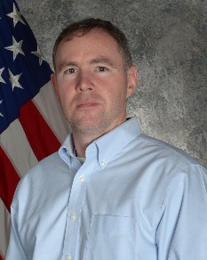
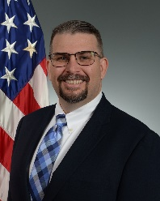
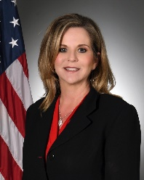
Functional Areas
Chief Engineer
Supply Chain Integrator
Diminishing Manufacturing Sources & Materials Support (DMSMS)/ Re-Engineering/Consolidated Sustainment Activity Group (CSAG)/General Support Division (GSD)/Test Program Software Product Lifecycle Management (PLM)
System Engineering Plan/Execution
OSS&E Compliance
STINFO Policy and Training
DLA 339, 202, 107 Metrics
Engineering Regulations and Policies
Lead Free Electronics and Counterfeit Parts
SC Liaison with mission partners to maintain Customer first perspective
Facilitates strategic oversight of SC activities
Identifies/recommends/drives SC improvements better serving the Customer
Performs independent analysis and process audits
Provides multi-organizational subject matter expertise across broad spectrum of SC processes
Synchronizes stakeholder efforts to achieve common goals
Mr. Jonathan Ringley
Mr. Jay Harrington
Depot Supply Chain Management (DSCM)
Supplier Relationship Management (SRM)
SCM Partners with DLA, ALC, and AFLCMC
Supports MX Depot Parts Requirements
Facilitates Timely Provision of Materiel
Reviews Operational and Strategic Supportability
Analyze Supportability Data
Interacts with process owners to resolve issues hindering Support (AFSCMAN 20-101)
Liaison Between Government and Suppliers
Creates & Maintains Effective, Collaborative, & Strategic Relationships with Suppliers
Identifies and Leverages Technological/ Process Improvements
Coordinates Business Development
Image Coming Soon
Ms. Kim Mattox
Ms. Thelma Davis

Slide 8
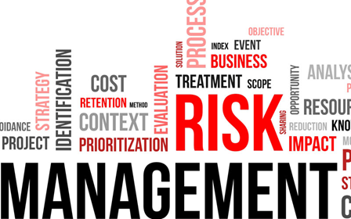
Supply Chain Challenges & Way Forward
Challenges
Way Forward:
Aging Weapon Systems
Parts Obsolescence
Aging Skilled Workforce
Fiscal Constraints
Procurement Prioritization
Maintenance Deferments
Small Fleet Dynamics
Minimum Order Quantities
Transitioning Weapon Systems
Divestiture Timing
Readiness Shift
Next Contingency/Mission Requirements
COVID-19 – new norms
Acquisition Cycle Times
Artificial Intelligence/Machine Learning
Data Sciences
Robotic Process Automation
Intensive Management of Budget
Supply Chain Risk Management
Condition-Based Maintenance⁺
Responsive/Resilient Supply Chain
Gov’t/Academia/Industry Partnerships

Slide 9
448th Supply Chain Management Wing
Supplying Warfighter Dominance

Slide 10
PEO-WSSCO-WSLO Alignment
B-1/B-52 WSLO John Eads
Bomber PEO
Brig Gen William Rogers
B-1, B-2, B-52
B-2/E-3 WSLO Kim Delosreyes
Fighter PEO
Brig Gen Dale White
WSSCO-Tinker
F-15C/D & E WSLO
Miguel Pina
A-10, F-15, F-16
ALCM, B-1, B-2, B-52, B-21,
E-3, KC-135
F-16 WSLO
Clint Thornton
Tanker/Mobility PEO
Mr. Paul Waugh
WSSCO-Robins
CV-22/HH-60/TH-1/UH-1 WSLO
Jack “Buddy” Leser Jr
C-5, C-130, KC-135, T-38
Digital PEO
Mr. Steve Wert
A-10 WSLO
Christian Olivo
C-5, C-130, C-130SOF, F-15C/D/E, HH-60, TH-1, UH-1
E-3
CV-22/C-5 WSLO
Hillary Mueller
Armament PEO
Brig Gen Heath Collins
WSSCO-Hill
C-130/C-130SOF WSLO Justine Robinson
ALCM, ICBM, NC-3
A-10, F-16, T-38, ICBM,
NC-3, Space/C3I
C3I & Networks PEO
MG Anthony Genatempo
KC-135/T-38 WSLO
Tasha Miles
ALCM, ICBM, NC-3, Space/C3I
Space/C3I
NC3 WSLO
Zach Warr
ISR and SOF PEO
Colonel Joshua Williams
Propulsion WSLO
Jennifer Reich
C-130SOF, Helos

Slide 11
Small Business Programs
Mr. Randy Miller
AFSC/SB-R

Slide 12
Purpose
Conducting outreach to encourage Small Business expansion in meeting the demands of the AF Mission in supporting the warfighter.
UNCLASSIFIED
Briefer: Randy Miller SB

Slide 13
Overview
AFSC Portfolio
Activities Supported
Role of Small Business Office
Role of Small Businesses
Source Approval Definitions
Source Approval Resources
Source Approval Process
Replenishment Parts Purchase or Borrow Program
AFSC/SB Contact Information
UNCLASSIFIED
Briefer: Randy Miller SB

Slide 14
Geographically Display of AFSC Footprint
UNCLASSIFIED
Briefer: Randy Miller SB

Slide 15
AFSC Maintenance Complexes
F-16, A-10, F-22, F-35, C-130, T-38, ICBMS
Landing Gear
Oklahoma City
Air Logistics Complex
KC-135, B-1, B-52,
E-3, E-6
Engines
Warner Robins
Air Logistics Complex
C-5, C-130, C-17, F-15
Avionics
91K Exchangeables
73K Exchangeables
123K Exchangeables
OFPs, Msn Planning, Test Equip, Support Equip, Msn Support
OFPs, Msn Planning, Test Equip, Support Equip, Msn Support
OFPs, Msn Planning, Test Equip, Support Equip, Msn Support
Ogden
Air Logistics Complex
Deployable Field Teams
Deployable Field Teams
Deployable Field Teams
WEAPON SYSTEMS
UNIQUE
CAPABILITIES
DAMAGE REPAIR
COMMODITIES
SOFTWARE
UNCLASSIFIED
Briefer: Randy Miller SB

Slide 16
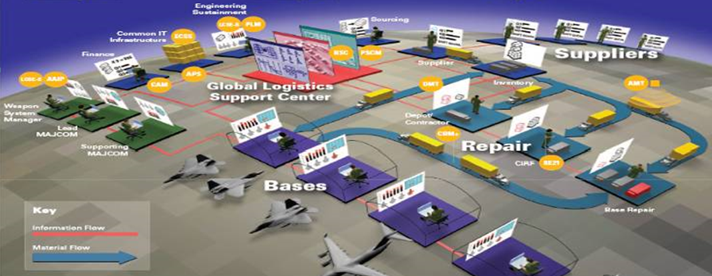
Supply Chain Wings
448th Supply Chain
Management Wing
~ Tinker AFB ~
635th Supply Chain
Operations Wing
~ Scott AFB ~
Single Air Force wholesale Supply Chain Management Wing
Management of critical items for the nation’s nuclear enterprise
Warfighter support through lens of Weapon Systems Asset Availability
Plan and execute repairable spares requirements
$6.2B budget authority
60+ partner nations
First-responders 24/7/365 for retail supply
100% Positive Inventory Control of Nuclear Weapons Related Materials (NWRM)
WRM global management
Vehicle/Equipment Mx Support (VEMSO)
AF Petroleum Agency (AFPET)
Basic Expeditionary Airfield Resources (BEAR)
Consolidated Mobility Bag Activity (CMBA)
Accurate & timely reporting of supply chain information for warfighter visibility
UNCLASSIFIED
Briefer: Randy Miller SB

Slide 17
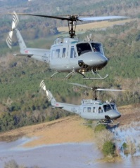
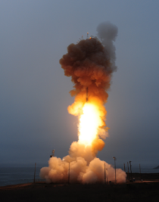
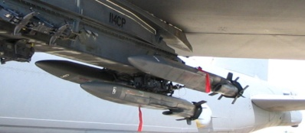
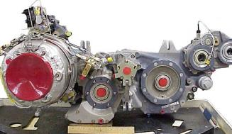
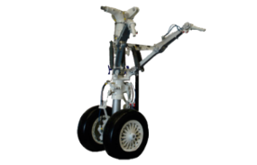
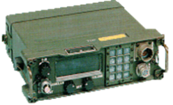
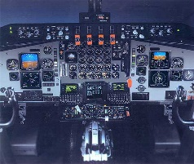
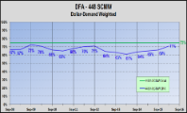
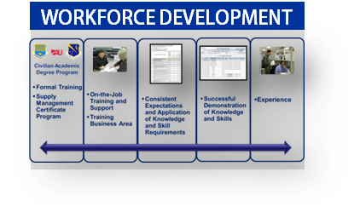
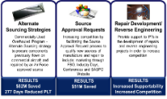
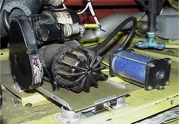
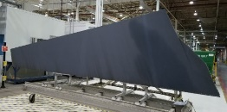
Scope of 448th Supply Chain
638th Supply Chain Management Group
Robins Air Force Base, Georgia
.
748th Supply Chain Management Group
Hill Air Force Base, Utah
Common Avionics
Electronics Warfare
Special Operations Forces/Personnel Recovery
Support Equipment
Auto. Test Systems & Vehicles
Armament
Global Hawk
Aircraft Structural and Avionics
Landing Gear
Secondary Power
Intercontinental Ballistic Missile
Space & Command, Control, Communications & Intelligence
APT T-X
F-35
848th Supply Chain Management Group
Tinker Air Force Base, Oklahoma
948th Supply Chain Management Group
Tinker Air Force Base, Oklahoma
Aircraft Accessories
Instruments
Aircraft Structures
Propulsion
KC-46
B-21
Enterprise Support for Performance Management, Business Processes & Procedures
Data Sciences & Analysis
Budget
Supply Chain Planning
Strategic Sourcing
Workforce Development
Supply Chain Operations Support
Foreign Military Sales
UNCLASSIFIED
Briefer: Randy Miller SB

Slide 18
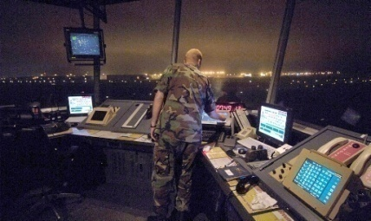
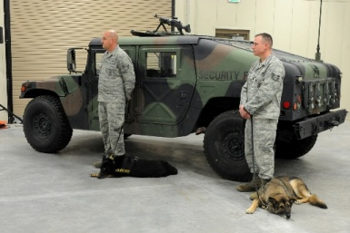
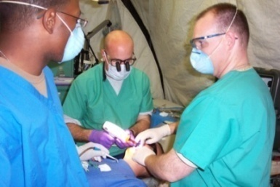
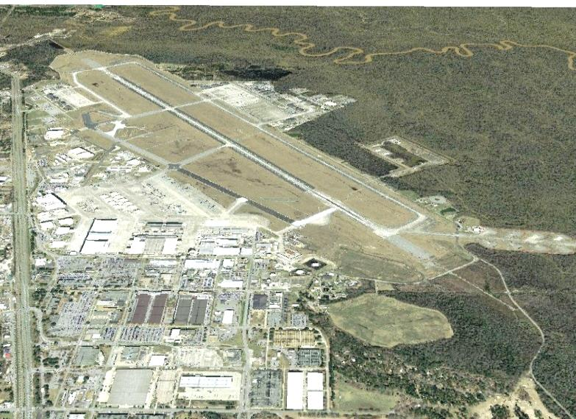
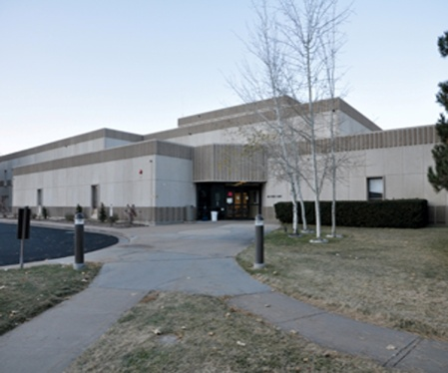
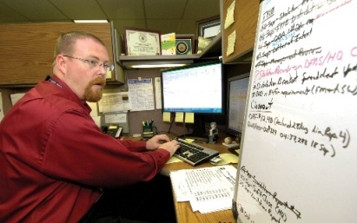
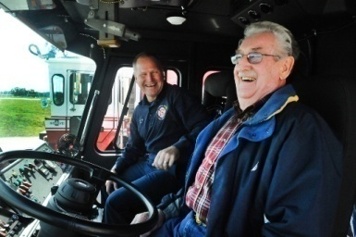
Air Base Wings
Airfield Management
Installation Security
Medical Support
Mission Support
Facilities/Infrastructure
Information Technology
Financial Support
Contractors
Families
Retirees
Airmen
UNCLASSIFIED
Briefer: Randy Miller SB

Slide 19
Role of the SB Office (Performs these services for AFSC, AFLCMC, and AFNWC)
Maximize SB Participation
Engage early with our acquisition teams
Provide Input on RFIs/Sources Sought Synopsis, if requested
Make Set-Aside Recommendations
Acquisition Strategy Panels
Publicize SB Programs
Counsel Contractors – Small Business Advocate
Advise what the Base/Complex/Supply Chain procures
Coordinate Inquiries/Guidance Requests
Small Business Administration (SBA) Liaison
Acquisition Strategy (NAICS; SB Set-Aside; Subcontracting Plans)
Size Challenges
Ref: DOD Directive 4205.01; AFI 90-1801; DFARS 219.201 & PGI 219.201; and AFFARS 5319.201
UNCLASSIFIED
Briefer: Randy Miller SB
Notes:
North American Industry Classification System is the standard used by Federal statistical agencies in classifying business establishments for the purpose of collecting, analyzing, and publishing statistical data related to the U.S. business economy.

Slide 20
Role Of the SB Office (cont.) (Performs these services for AFSC, AFLCMC, and AFNWC)
SB Outreach
Interaction with Industry; Tinker & the Primes; Indian Country Business Summit; Dixie Crow – Symposium; local PTAC Events, Industry Days, etc.
Education
Internal and External Customers
Advise & Assist Acquisition Personnel on SB Matters
Track SB Performance Expectations (SLPE)
(AKA: Small Business Goals)
Source Development
Market Research/Sources Sought
Source Approval Request (SAR) Process Focal Point
Ref: DOD Directive 4205.01; AFI 90-1801; DFARS 219.201 & PGI 219.201; and AFFARS 5319.201 and FAR Subpart 10. SAR process AFMCI 23-113
UNCLASSIFIED
Briefer: Randy Miller SB
Notes:
Market Research…Most Important
Acquisition Strategy is determined by the results of Market Research.
Market Research
Most influential time to identify small business opportunities
Rule of 2: Is there a reasonable expectation of obtaining offers from two or more responsible Small Businesses
If a small business can do some of the work, is there opportunity for teaming or possible break-out?
AFI 23-113 SAR Process

Slide 21
Role of Small Businesses
Educate yourself on who is buying what you’re selling
SAM.gov
USASpending.Gov
Utilize your Procurement Technical Assistance Centers (PTAC offices) first, then contact DoD agencies
Learn to speak the language (FAR, DFAR, AFFARS, LPTA, Best Value, Contract Clauses) http://acquisition.gov
Learn the strategic contracts the Gov’t uses (OASIS, 2GIT)
WWW.Sam.Gov is point of entry to Gov’t contracts
Send capability statements to SBOs
Schedule one on one meetings
Air Force Sustainment Center SBO website has numerous resources: Air Force Sustainment Center > Units > SBO (af.mil)
UNCLASSIFIED
Briefer: Randy Miller SB
Notes:
MOST IMPORTANT CHART…Our SMALL BUSINESS OFFICE WEBSITE contains a link with one-page of important links!
AFSC Small Business Office Website at www.afsc.af.mil/units/sbo/index.asp contains information and links to additional information sites to assist SBs.
YOUTUBE Videos on how to use SAM.gov
To find out who is buying what you’re selling, use the following systems (PTACs will offer free training classes on how to use)
SAM.gov has a report section
USASpending.Gov
Strategic Contracts:
- OASIS (One Acquisition Solution for Integrated Services)
- NETCENTS II (IT solutions)
- Ability One (Janitorial Support at Tinker)
- AFICA mandatory list
Other Transaction Authority
SBIR/STTR Program

Slide 22
How Can You Effect Acquisition Strategy?
RESPOND!! RESPOND!!! RESPOND!!!
Request for Information (RFIs)
Sources Sought Synopsis
Industry Days/Outreach Events
Talk up your capabilities and value added proposition….not business size
Let Government know your intentions
Prime
Limitations in subcontracting
Sub-Contractor
What skill-sets and percentage can be performed
Keep your profiles up to date
Dynamic Small Business Search (NAICS, Keywords, Perf History)
UNCLASSIFIED
Briefer: Randy Miller SB
Notes:
Important to advise the acquisition if you can perform as a prime or subcontractor.
Telling the acquisition team what capabilities you can perform will help justify the subcontracting goals

Slide 23
How to Find AFSC Requirements
Search by DoDAAC (DoD Activity Address Code)
Identifies installation/organization with contracting authority
Air Force Sustainment Center (AFSC) DODAACs (Tinker/Robins/Hill DoDAAC list on SBO website at https://www.afsc.af.mil/Units/SBO.aspx)
Tinker Air Force Base - Lead (Tinker), FA81**
Warner Robins Air Force Base (Robins), FA85**
Hill Air Force Base (HAFB), FA82**
Review opportunities to obtain specific DoDAACs
Other Search Engines to identify your competitors
SAM.gov
USASpending.Gov
UNCLASSIFIED
Briefer: Randy Miller SB

Slide 24
DOD Spare Parts Breakout Program
Acquisition Method Code (AMC): Single digit numeric code to describe to the contracting officer/other government personnel the results of a technical review of a part and its suitability for breakout
Acquisition Method Suffix Code (AMSC): Single digit alpha code assigned by a DOD activity which provides the contracting officer/other government personnel with engineering, manufacturing, and technical information
UNCLASSIFIED
Briefer: Randy Miller SB

Slide 25
Breakout Codes
AMC | Description
1 | Suitable for competitive acquisition for the second or subsequent time
2 | Suitable for competitive acquisition for the first time
3 | Acquire for the second or subsequent time from the actual manufacturer
4 | Acquire for the first time from the actual manufacturer
5 | Acquire from the sole source contractor which is not the actual manufacturer
UNCLASSIFIED
Briefer: Randy Miller SB

Slide 26
Breakout Codes (cont.)
AMSC | Description
A | The Government’s right to use the data is questionable
B | Must be bought from source(s) specified on a source control drawing
C | Part requires engineering source approval by the design control activity in order to maintain the quality of the part
D | Data is not physically available
G | The Government has the rights to the data package and it is complete
H | The Government does not have sufficient, accurate, or legible data
K | Part must be produced from class 1 castings
L | Annual buy value falls below the screening threshold for competitive buys
AMSC | Description
M | Master tooling is required to manufacture
N | Special test/inspection equipment/facilities are required
O | Code not assigned, screening incomplete
P | Right to use the data is not owned by the Government
Q | Government does not have rights to data - data availability is expected to be achieved
R | Government does not have data - uneconomical to purchase data
S | Restricted to Gov’t approved source(s)/mil sensitive technology
T | Part controlled by Qualified Products List (QPL)
U | Cost to compete the item has been determined to exceed savings
V | High reliability part
Y | The design of the item has been determined unstable
Z | Commercial non-developmental, off-the-shelf type item
UNCLASSIFIED
Briefer: Randy Miller SB

Slide 27
AMC/AMSC Targets
Restricted
“C” Codes Best Candidates for SARs
Require Engineering Approval
Data Usually Available
Specification Qualification Requirement Criteria Applies
“G” Codes do not require pre-qualification or submission of a SAR package. Data complete and furnished with solicitation.
UNCLASSIFIED
Briefer: Randy Miller SB

Slide 28
Definitions
Critical Application Item (CAI):
An item essential to weapon system performance or operation, or the preservation of life or safety of operating personnel, as determined by the military services.
Critical Safety Item (CSI):
A part, assembly, installation equipment, launch equipment, recovery equipment, or support equipment for an aircraft or aviation weapon system if the part, assembly, or equipment contains a characteristic any failure, malfunction, or absence of which could cause:
a catastrophic or critical failure resulting in the loss of or serious damage to the aircraft or weapon system;
an unacceptable risk of personal injury or loss of life; or
an uncommanded engine shutdown that jeopardizes safety.
UNCLASSIFIED
Briefer: Randy Miller SB

Slide 29
Definitions (cont.)
Source Approval Request (SAR):
A technical data package submitted by a contractor which includes all data/documentation/information required for a competent manufacturer/repair source to manufacture or repair an item, including a Critical Safety Item, to a level of quality that is equal or better than an OEM part.
Source Development (SD):
Function assigned within the Small Business Office at Air Logistics Complexes to increase competition within the supply chain. The Source Development Specialist manages the SD function of the SB program.
UNCLASSIFIED
Briefer: Randy Miller SB

Slide 30
Engineering Support Activity (ESA)
Assign/Document Item-Criticality
Critical Safety Item
Critical Application
Non-Critical
Determine Need/Establish/Maintain Record of Qualification Requirements
ESA Responsible for the SAM.GOV Announcement of QRs
Review/Evaluate SARs
UNCLASSIFIED
Briefer: Randy Miller SB

Slide 31
Source Development Specialist
Manages the Qualification/Source Development Function of the SB program
Acts as the Primary Liaison with Industry on all SARs not on solicitation
Review Non-Technical Aspects of SARs
Notifies Source when approved/disapproved
Notifies Contractor when removed pursuant to FAR 9.207 (a)
UNCLASSIFIED
Briefer: Randy Miller SB

Slide 32
AFSC Supply Chain Opportunities
Strategic Alternate Sourcing Program Office (SASPO) publishes the Requirements Projected on the Web (RPOW) lists biannually (Spring and Fall) on their website and sam.gov.
Tinker.af.mil/Home/429SCMS-SASPO/ , RPOW can be found under “SASPO Products” section
RPOW lists provide a 3-year projection of National Stock Numbers (NSN) estimated to be procured for the AFSC Supply Chain (Hill, Tinker, and Robins). Spares and Repairs lists include NSNs that require qualification, and the G-coded list includes NSNs that do not require qualification
Column B of the RPOW lists includes the AFSC location that manages the specific NSN, OO= Hill AFB, OC= Tinker AFB, WR= Robins AFB
**Disclaimer: The projections contained in the RPOW spreadsheets may or may not generate due to variability in customer demands and priorities. The forecast data is for planning purposes only and does not constitute an invitation for bid or request for proposal, and is not a commitment by the government to purchase the described items.
UNCLASSIFIED
Briefer: Randy Miller SB

Slide 33
Source Qualification Steps
I found an NSN that I believe my company is qualified to manufacture or repair, now what?
If you find an NSN on one of the lists that you believe your company is eligible to qualify for, the next step is to locate the associated Engineering Data List or Repair Data List (EDL/RDL) and the Manufacturing/Repair Qualification Requirements (MQR/RQR) for the specific NSNs.
Tinker AFB managed parts use the MQR/RQR’s located on the SASPO website.
Hill and Robins AFBs have part (NSN) specific qualification requirements. To obtain this information, please reach out to the respective Source Development Specialist for the associated data list and qualification requirement for the specific NSN.
I have the data list for the part, now how do I gain access to the data?
Data and drawings may be purchased through the Tinker AFB Public Sales Office and Technical orders may be purchased through the Tinker AFB Technical Order Sales office for AFSC requests. TECHNICAL ORDERS AND ENGINEERING DRAWINGS > Hill Air Force Base > Display (af.mil)
You must have an approved DD2345 (Joint Certification Program) to access sensitive data. Information on how to receive this can be found here JCP Home (dla.mil)
UNCLASSIFIED
Briefer: Randy Miller SB

Slide 34
Source Qualification Cont’d
I want to proceed with this information and become a qualified source, where do I go from here?
You will need to prepare a source approval request (SAR) package in accordance with AFMCI 23-113 Attachment 6, and the associated qualification requirement for the NSN
The SASPO website has many resources available, including SAR templates, training, and other resources available to assist in SAR preparation.
I’m ready to submit my SAR package, where do I send it?
Once you have completed your SAR package and are ready to submit, contact the Source Development Specialist and request a DoD SAFE link so the SAR may be submitted electronically
Once the Source Development Specialist receives the SAR, a non-technical review is completed, and the SAR sent to the cognizant engineer for review/approval
If approved/disapproved, you will receive a letter with details of your approval/disapproval
** Please note, becoming an approved source does not guarantee you will be awarded a contract. You will be eligible to propose on any solicitations for the part for which you become qualified.
UNCLASSIFIED
Briefer: Randy Miller SB

Slide 35
Replenishment Parts Purchase or Borrow Program (RPPOB)
References DAFMAN 23-119 and DoD Manual 4140.01, Volume 9
This Program is designed to loan assets (when available) to contractors to use to develop manufacturing and/or repair processes to become competitive sources
The Source Development Specialist within the Small Business Office is the focal point for bailment agreements (or loans) of parts for qualification.
Requests shall be sent to the small business office to begin the process.
UNCLASSIFIED
Briefer: Randy Miller SB

Slide 36
Questions?
Visit AFSC/SB Website:
https://www.afsc.af.mil/units/sbo.aspx
AFSC/SB-R email: randy.miller.22@us.af.mil
Phone: (478) 926-5871
UNCLASSIFIED
Briefer: Randy Miller SB

Slide 38
WR-ALC Overview:
Robins AFB Industry Day
NH-04, Michael (Tim) Lawrence
WR-ALC/OB
24 March 2023

Slide 39
Classification
“This briefing is unclassified and will not go above unclassified”
WR-ALC - Warner Robins Air Logistics Complex
UNCLASSIFIED

Slide 40
Purpose
To provide a WR-ALC capabilities overview to all customers.
UNCLASSIFIED
Briefer: Tim Lawrence (WR-ALC/OB)

Slide 41
Overview
WR-ALC “WE ARE” Mission Video
WR-ALC Mission, Vision and Motto
WR-ALC… By The Numbers
Quality Management System
Technology Repair Center (TRC) Responsibilities
WR-ALC…What We Do
Public Private Partnerships
Business Development
UNCLASSIFIED
Briefer: Tim Lawrence (WR-ALC/OB)

Slide 42
“We Are” Mission Video
https://usaf.dps.mil/sites/21617/OM/Mission%20Briefing/WR-ALC%20Mission%20Video/Aug24%20Wr%20Alc%20Final%20-1.m4v
UNCLASSIFIED
Briefer: Tim Lawrence (WR-ALC/OB)

Slide 43
WR-ALC Core Mission
Mission Statement:
Deliver Air Power and Combat
Readiness for Our Nation!
Vision:
Depot of Choice - Integrated Team Delivering Innovative
Capabilities.
Motto:
We Deliver Airpower...Period!
UNCLASSIFIED
Briefer: Tim Lawrence (WR-ALC/OB)
43

Slide 44
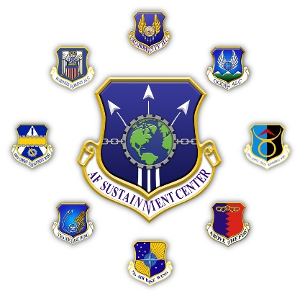
WR-ALC…By The Numbers
Mission
1 of 3 Air Force Air Logistics Complexes
People
7,295 Civilians
96 Military
272 Contractors
Infrastructure
165 Facilities
5.1M SF, $1.8B Replacement Cost
Off-Installation Facilities
Project Synergy Software Facility
Blue Sky Software Facility
Macon Airport “Robins North”
UNCLASSIFIED
Briefer: Tim Lawrence (WR-ALC/OB)

Slide 45
Quality Management System
Certificate of Conformance: AS9110 & ISO9001 standard to aerospace
MANAGEMENT OF DEPOT LEVEL MAINTENANCE, ELECTRICAL, MECHANICAL & SOFTWARE DESIGN, PRODUCTION AND MANUFACTURING FACILITIES AND LABORATORIES IN THE RESORATION OF GOVERNMENT EQUIPMENT AND AIRCRAFT TO SERVICABLE CONDITION TO MEET READINESS REQUIREMENTS
UNCLASSIFIED
Briefer: Tim Lawrence (WR-ALC/OB)

Slide 46
Center of Industrial and Technical Excellence (CITE)
CITE designation established by SECAF in 2001 per Title 10 USC 2474
Authorizes depots to enter into public-private partnerships to perform work related to depot maintenance core competencies of each CITE
Fosters cooperation between the armed forces and private industry, thereby capitalizing on the best capabilities of each sector in providing best value to the war fighter and the taxpayer
All 3 AF depots are CITEs: OC-ALC,OO-ALC, and WR-ALC
AF Technology Repair Center (TRC) designation identifies source of repair locations
Designates the core competencies of the AF CITEs
Identifies candidate depots for the Source of Repair Assignment Process
Supports execution of long-range workload planning processes
UNCLASSIFIED
Briefer: Tim Lawrence (WR-ALC/OB)
46
Notes:
Depot Maintenance Statute - 10 USC 2474
This purpose of this statute is to foster the excellence of DoD depot-level maintenance activities and military arsenal facilities by requiring their designation as CITEs, by promoting the use of best practices at the CITEs, and by optimizing the efficient and effective operation of the CITEs through their collaboration with commercial firms in PPPs. Specific CITE enhancements envisioned in CITE/commercial PPPs include:
Maximizing CITE utilization,
Reducing/eliminating CITE ownership, operation and environmental restoration costs,
Reducing the costs of products repaired at the CITEs,
Leveraging commercial investment in the CITE plant/equipment recapitalization, and
Promoting the undertaking of commercial ventures at the CITES.
Additionally, the statute seeks to foster cooperation between the armed forces and private industry, thereby capitalizing on the best capabilities of each sector in providing best value to the war fighter and the tax payer.

Slide 47
TRC Responsibilities
TRC 3: Electrical Power Components
TRC 4: Electronic Support Equipment
TRC 6: Airborne Electronics
TRC 7: Command, Control, Communications, Computer, and Intelligence (C4I)
TRC 9: Hydraulics/Pnedraulics/Pneumatics: Air Vehicle Fire Bottle Equipment
TRC 11: Life Support Systems: Life Support Equipment and Egress Systems
TRC 13: Propellers: Fixed Wing Aircraft
TRC 16: Photographic/Reconnaissance Imaging
TRC 17: Training and Simulation Equipment
TRC 18: Instruments/Displays: Gyros
TRC 19: Airframe/Aircraft Related: Airlift Aircraft, Special Operations Forces Aircraft, Joint Surveillance Target Attack Radar System (JSTARS). Unmanned Aerial Vehicles including but not limited to C-5, C-17, C-130, RQ-4, MQ-9, U-2, F-15
TRC 23: Software
UNCLASSIFIED
Briefer: Tim Lawrence (WR-ALC/OB)

Slide 48
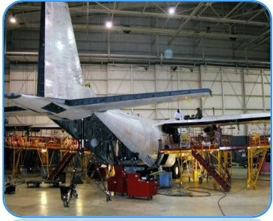
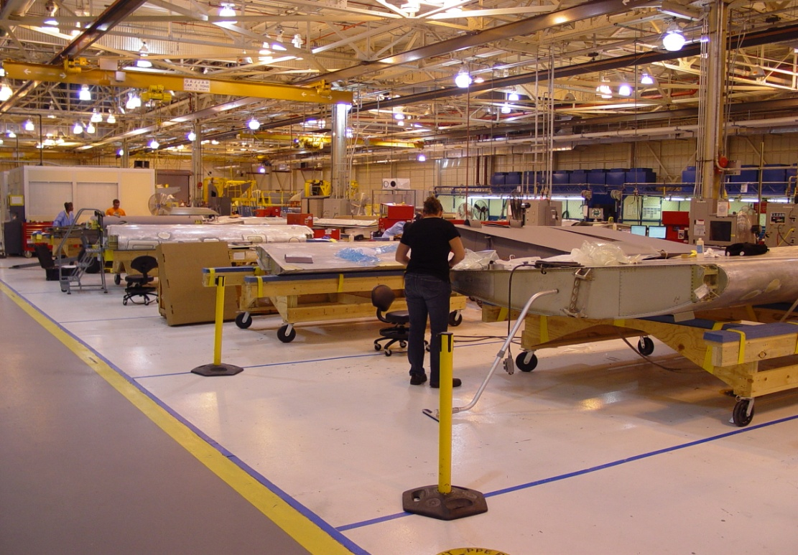
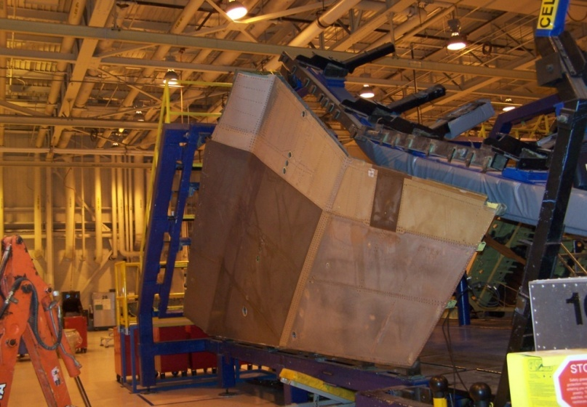
WR-ALC…What We Do
402 AMXG Capabilities Include:
PDM, Modifications, and Installs
C-5
C-17
C-130
F-15
Depaint & Corrosion Control Hangars
Paint
Non-Destructive Inspection (NDI)
Depot Field Teams
Rapid Aircraft Battle Damage Repair
Testing
402 CMXG Capabilities Include:
Sheet Metal, Metal Bonding, Composites
SE Largest Aerospace Electroplating Facility
Non-Destructive Inspection (NDI)
FLASHJET Depaint for Composites
3D Printing, Additive Manufacturing
Plating and Heat Treat
Robotic Core Milling Machine
Climate Controlled Paint Booths
Modern Sheet Metal Manufacturing Facility
CNC Machining and Turning Center
Aircraft Seat Repair
3-Axis and 5-Axis Machines
Life Support Items Repair
Flight Controls & Structures Fuel Cells Repair
Mobile Composite Repair Capabilities
Welding and Tube Manufacturing
Coordinated Measurement Machine (CMM) Lab
Fiberglass and Plastics Repair
Advanced Metal Finishing Facility (AMFF)
Largest Fluid Cell Press in North America
C-130 Propeller Assembly Overhaul
Halon Recovery/Recycling and Fire Bottle Repair
Battery and Bearing Shop
Horizontal, Vertical, Universal Milling Machines
Parachute and Fabric Repair
Thrust Reversers & Metal Tanks Repair
Tubing/Cables/Brackets/Fittings Manufacturing
Skins/Ribs/Spars/Panels Manufacturing
UNCLASSIFIED
Briefer: Tim Lawrence (WR-ALC/OB)

Slide 49
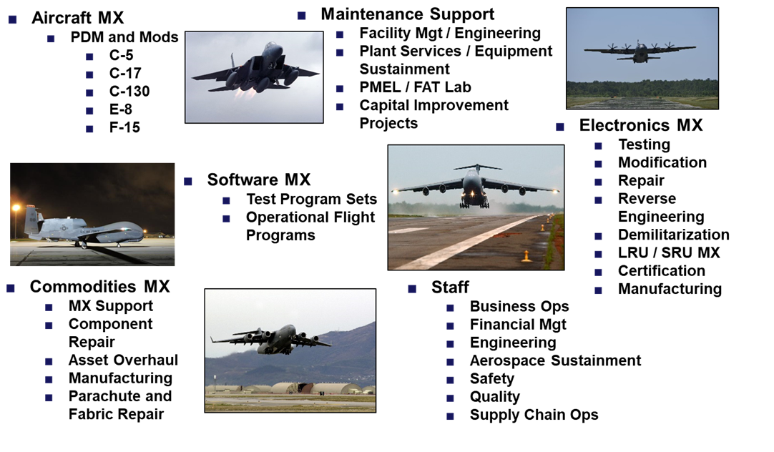
WR-ALC…What We Do
402 EMXG Capabilities Include:
Precision Attack
Common/Fighter Avionics
Communications
Gyroscopes
Fire Control Radar
Radar Warning
Laser Target Acquisition
Reverse Engineering/Avionics Redesign and Manufacturing (REARM)
22,000 SF Clean Room Space
Painting Facilities
Storage and Disposal of Hazardous Materials
Indoor/Outdoor Radar Ranges
Printed Wiring Circuit Board Mfg. Facility
Storage and Repair of Classiﬁed Units
Interface Test Adapter Assemblies
Flexible and RF Cable Manufacturing
Electrical and Environmental Testing
Electronic Warfare
Electronic Manufacturing
Navigation
Electronic Instruments
Chaﬀ and Flare Dispensers
Electronic Jamming
Infrared Sensors
650,000 SF Secure/Environmentally Controlled Space
Screen/Shielded Room Operations
Safe Firing Laser Rooms
On-Site Hazardous Materials Distribution Pharmacy
MIL-Certiﬁed Hybrid Microelectronic Facility
Electrical/Utility Raceway Systems
ESD1 Rated Electronic Repair Areas
Single/Multi-Layer Printed Wiring Boards
Tool Design and Modiﬁcation
Versatile Depot Automatic Test Stations (VDATS)
402 MSXG Capabilities Include:
AGE/GSE Maintenance
Capital Investment Program (CIP)
Corrosion Control & Prevention
Energy Assurance/Resiliency
Environmental Compliance
Ergonomics-Admin/Production Areas
Facilities Maintenance & Repair
Facility Management/Engineering
First Article Veriﬁcation
Hazardous Materials/Waste Disposal
NDI Training/Certiﬁcation
On-Site Calibration
Plant Services/Equipment Sustainment Pollution Prevention (P2)
Prototype Fabrication
Custom Test of Components/Materials
Failure Analysis of Aerospace Components
Material/Chemistry Testing
OSHA Compliance
UNCLASSIFIED
Briefer: Tim Lawrence (WR-ALC/OB)

Slide 50
WR-ALC…What We Do
402 SWEG Capabilities Include:
State-of-the-art Software Facilities
OFP Software Support
ATE Software Development/Maintenance
TPS Rehosting
System Engineering Services
Depot Shop Automation Tools
Mission Computer Programming
High Fidelity Models and Simulations
Data Recording and Monitoring Tools
Business Enterprise Systems
Specialty in Avionics/Communications/Radar
OFP Simulation and Analysis
TPS Software Development/Maintenance
Interface Test Adapters
Independent Veriﬁcation and Validation
Software Feasibility Studies
Software Development, Maintenance, and Consulting
Mission Planning Software
In-Circuit Debugging
Cybersecurity & Information Assurance
Electronic Flight Bags
OFP Specialty in Radar and Electronic Warfare Systems
UNCLASSIFIED
Briefer: Tim Lawrence (WR-ALC/OB)

Slide 51
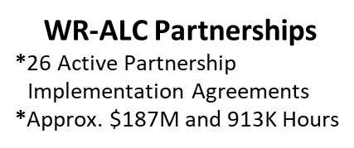
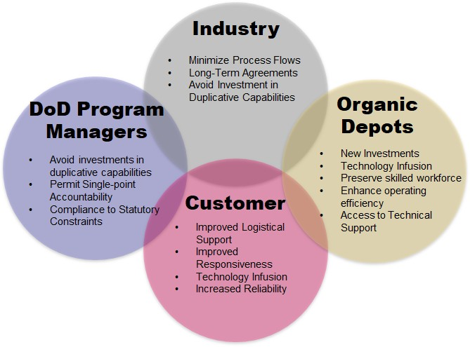
Public Private Partnerships
Successful Partnerships
*Start early
*Mutual trust
*Senior-level support
*Support balanced workloads
*Long-term relationships
*Shared vision & objectives
Depot Partnering Capabilities
What are the Benefits?
1 million square feet of state-of-the-art manufacturing & repair facilities including CNC machining capability and metal bond &
composite repair
Repair, overhaul, and manufacture Avionics
Operational Flight Program (OFP), Automatic Test Equipment (ATE), and Test Program Set (TPS) software
UNCLASSIFIED
Briefer: Tim Lawrence (WR-ALC/OB)

Slide 52
Types of Partnerships
UNCLASSIFIED
Briefer: Tim Lawrence (WR-ALC/OB)

Slide 53
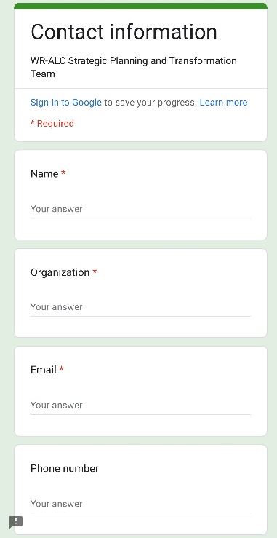
Business Development
Business Card
Contact Request
UNCLASSIFIED
Briefer: Tim Lawrence (WR-ALC/OB)

Slide 55
UNCLASSIFIED
Georgia Tech APEX Accelerator
Program and Services Overview
Robins AFB SASPO Industry Day 24 March 2023
UNCLASSIFIED
UNCLASSIFIED

Slide 56
Presenter Contact Information Georgia Tech APEX Accelerator
UNCLASSIFIED
Nancy Cleveland
Atlanta Office
Program Manager, APTAC Region 4 Director Certified Procurement Professional (CPP) nancy.cleveland@innovate.gatech.edu
Aileen Zoellner Warner Robins Office
Certified Procurement Professional (CPP)
aileen.zoellner@innovate.gatech.edu
Bridget L. Bennett Albany Office
Certified Procurement Professional (CPP)
bridget.bennett@innovate.gatech.edu
UNCLASSIFIED
“This APEX Accelerator is funded in part through a cooperative agreement with the Department of Defense.”

Slide 57
APEX Accelerators, formerly known as Procurement Technical Assistance Centers
UNCLASSIFIED
Establishment
Purpose & Funding
GT APEX Accelerators
1985 DoD Authorization Act
97 PTACs across the nation incl. the District of Columbia, Puerto Rico and Guam
PTACs specializing in assistance to federally recognized Indian Tribes, Alaskan and Hawaiian Native entities
Help expand businesses pursue and perform under government contracts – federal, state and local
NDAA legislation
Administered by Defense Logistics Agency
Local host organizations; e.g., state, local and non- profits
Operating more than 35 years – part of EI2
Locations throughout GA
Albany
Atlanta
Augusta
Carrollton
Columbus
Gainesville
Savannah
Warner Robins
UNCLASSIFIED
47

Slide 58
Georgia Tech APEX Accelerator … Who We Are!
UNCLASSIFIED
Georgia Tech APEX Accelerator
is a statewide program; (8) centers-locations; seven (7) Procurement Counselors serving the entire State of Georgia. We have over 2,ooo active clients in our database. To find your local center, go to our team directory: https://gtpac.org/team-directory/
Center Locations:
Albany
Atlanta
Augusta
Carrollton
Columbus
Gainesville
Savannah
Warner Robins
Georgia Tech APEX Accelerator is funded in part through a cooperative agreement with the Department of Defense, and with the Georgia Tech (GT) Enterprise Innovation Institute (EI²).
perative agreement with the Department of Defens

Slide 59
Department of Defense Office of Small Business Programs APEX Accelerators Program
UNCLASSIFIED
APEX Accelerators | Accelerating American Entrepreneurs
https://www.apexaccelerators.us/#/about-us
The APEX Accelerators program, formerly known as Procurement Technical Assistance Program (PTAP), under management of the Department of Defense (DoD) Office of Small Business Programs (OSBP), plays a critical role in the Department’s efforts to identify and helps a wide range of businesses enter and participate in the defense supply-chain. The program provides the education and training to ensure that all businesses become capable of participating in federal, state, and local government contracts.

Slide 60
Georgia Tech APEX Accelerator … What We Do!
UNCLASSIFIED
Georgia Tech APEX Accelerator helps Georgia businesses identify, compete for, and
win government contracts. Our assistance comes in the forms of teaching, mentoring, and coaching. Our services are available at no cost to any Georgia business, large or small, that possesses the interest and potential to perform work — as a prime contractor or a subcontractor
— for defense, federal, state, or local government.
Seminars
Webinars
Workshops
Outreach
Events
One-on-One Counseling
Bid Match
Services
We help businesses navigate the government procurement processes to become procurement ready in the government industrial base (GIB) and in the defense industrial base (DIB).
Our services include training; one-on-one counseling; computerized bid matching services;
and tools to help businesses succeed in the government marketplace.
Georgia Tech APEX Accelerator services are free, offered at no cost to Georgia businesses.
For further information;
Georgia Firms, go to www.gtpac.org
Out of State Firms, go to https://www.aptac-us.org/contracting-assistance/
UNCLASSIFIED

Slide 61
Georgia Tech APEX Accelerator … Training Topics
UNCLASSIFIED
Introduction to Government Contracting | Fundamentals of Navigating SAM and Working with the Government
Selling to the Military | Wide Area Work Flow Invoicing System
Working Successfully with Small Business Specialists | Marketing to State and Local Government Agencies
Preparing Successful Bids & Proposals | Cost & Price Proposal Preparation
Subcontracting with Large Primes | Teaming Agreements
All Small Business Mentor-Protégé Program | Understanding the Federal Acquisition Regulations – FAR, DFARS
Navigating SAM.gov | Cybersecurity 101 for Contractors
“Before the Storm” – Disaster Recovery Contracting | Contract Data Mining – How to Find Government Contract Opportunities
Woman-owned Small Business Program | HUBZone Program – How to Get Certified
Service Disabled/Veteran-Owned Business Verification | Understanding the GSA Schedules Process
Creating Capabilities Statements and Your Elevator Speech | Small Business Certifications 51
UNCLASSIFIED
UNCLASSIFIED

Slide 62
Some of Our Partners and Resources
UNCLASSIFIED
SBA
www.sba.gov
SCORE
https://www.score.org/
SBA
www.sba.gov
Small Business Development Centers UGA SBDC (georgiasbdc.org)
SBA
www.sba.gov
Veteran Business Outreach Center
GA VECTR: Georgia Veterans Education Career Transition Resource Center | VBOC
Team GA Marketplace Georgia Department of Administrative Services (ga.gov)
GA Department of
Transportation (GDOT)
Small Business Program (ga.gov)
General Services Administration (GSA) Office of Small and Disadvantaged Business Utilization | GSA
National APEX Accelerators (Formerly Known PTACs) https://aptac-us.org/
Other Government Agencies and Public Entities
UNCLASSIFIED
52

Slide 63
Determine Your Suitability for Government Contracting
UNCLASSIFIED
The Government Marketplace poses unique challenges that may overwhelm or ruin a company based upon the maturity or resources needed to meet these challenges.
Suitable Company Infrastructure for Government Contracting:
Business Plan
Accounting System
Past Performance
Marketing Plan
Financial Soundness/Access
Requisite Registrations
UNCLASSIFIED
53

Slide 64
Company’s Self-Assessment for Government Contracting
UNCLASSIFIED
What do you do “Best?”
What is Your “Target Market?”
Are they ‘Buying What You Are Selling?” Who “Bought” It?
Who “Won” It?
Can You “Sell” it?
Are You “Equipped to Win & Execute?”
64

Slide 65
7
7 Steps of Government Contracting
UNCLASSIFIED
6
5
4
Perform
3
Prepare Bids & Proposals
2
Find Opportunities
Build and Consult Reference Library
1
Know the Right People
Market Planning & Research
Registration SAM.gov for
Federal Contracting Mandatory
55

Slide 66
Federal Small Business Certifications
“Set-Asides”
UNCLASSIFIED
https://www.sba.gov/federal-contracting
Federal U.S. Small Business Administration (SBA) Certifications
Woman Owned Small Business (WOSB)/ Economic Disadvantaged (EDWOSB)
Veteran Owned Small Business (VOSB)/ Service-Disabled (SDVOSB)
HUBZone
8(a) Business Development Program
UNCLASSIFIED
56

Slide 67
Federal Government’s System for Award Management (www.SAM.gov)
UNCLASSIFIED
The System for Award Management (SAM) Registration is required prior to …
–
Applying for federal small business certifications www.sba.gov
– Bidding on federal contracting opportunities.

Slide 68
Small Business Specialists
UNCLASSIFIED
Every Federal agency has an Office of Small Business Programs
https://www.acquisition.gov/procurement-forecasts/small-business https://www.va.gov/OSDBU/entrepreneur/businessFederalAgencies.asp

Slide 69
Finding Federal Government Opportunities
UNCLASSIFIED
•
https://sam.gov/content/opportunities
https://business.defense.gov/Acquisition/Subcontracting/
https://www.acquisition.gov/procurement-forecasts
https://www.transportation.gov/osdbu/procurement- forecast/summary/2021
https://sam.gov/content/about/external-resources
https://web.sba.gov/pro-net/search/dsp_dsbs.cfm
SBA SubNet

Slide 70
Pulling It All Together
UNCLASSIFIED
Terms & Conditions:
Respond to our requests for respond to the 5-question quarterly surveys about you bids and whether you won any government (federal, state, local, and/or subcontracting) awards
Respond to our annual quality of service survey
GaTech APEX Accelerator’s Clients
benefit from:
–An automated bid search system
–Notices of upcoming events
–Training and instruction
–One-on-one counseling and advice
Sign-up | Become A Client
https://gtpac.ecenterdirect.com/signup

Slide 71
Upcoming Webinars & Events
https://gtpac.ecenterdirect.com/events
UNCLASSIFIED

Slide 72
Any Questions?
UNCLASSIFIED
Contact The Georgia Tech APEX Accelerator Team
https://gtpac.org/team-directory/
“This APEX Accelerator is funded in part through a cooperative agreement with the Department of Defense.”
UNCLASSIFIED
UNCLASSIFIED

Slide 73
Strategic Alternate Sourcing Program Office (SASPO)
Summer Wishon
429 SCMS/GUMD
March 24, 2023
UNCLASSIFIED

Slide 74
Classification
The classification of the brief is unclassified and the discussion can go up to unclassified

Slide 75
Purpose
To provide overview of Strategic Sourcing.

Slide 76
Overview
Purpose
Strategic Sourcing Programs
Source Approval Requests (SAR)
Repair Development/Reverse Engineering (RE/RD)
Other Transaction Authority (OTA)
Sustaining Engineering (SE)
Contact Information

Slide 77
Strategic Alternate Sourcing Program Office (SASPO)
Centralized Cross-Functional Support Team with Targeted Results
Diminishing Manufacturing Sources & Material Shortages
Predictive Tool
Analysis & Resolution
Policy Oversight & Mgmt
* Strategic Alternate Sourcing Program Office *
SASPO
Strategic Sourcing
Source Approval Requests (SARs)
Alternate Sourcing Strategies
Reverse Engineering/Repair Development
Marketing Strategies
End of Life (EOL)
Other Transaction Authority (OTA)
Provides policy
Manages web-based tool MPST
Increase Supportability
Increase Availability
Increase Competition
Reduce Costs
Notes:
Not just AFSC specific. SASPO supports any AF organization seeking our assistance whether it be finding a source, initiating a SE project or performing DMSMS analysis. Additionally we have supported DLA and the FAA. We support our HQ AFMC/A4/10/A4-EN and HAF/SAF/AQ in representing the AF at OSD conferences and Working Group meeting for the purpose of developing DMSMS Policy and training.
Provide the B-52 program with the TF33 Obsolescence analysis that supported the decision to re-engine the B-52 aircraft
System Study for B-52 EGRESS
Now supporting Space Force
Investigating possibility of providing DMSMS support of Joint Service V-22 program

Slide 78
Strategic Sourcing
Enterprise Focused Sourcing Solution Program Office
Liaison Between USAF Requirements and Private Industry
Socialize Forecasted Supply Chain Requirements
SASPO Products
Requirements Projection on the Web (RPOW)
Target List Competitive (1-2 sources already approved)
G-code List Full and Open Competition

Slide 79
Strategic Sourcing – Source Approval Requests
Increasing competition by facilitating the SAR process to qualify new sources of manufacture and repair
Marketing through SAM.gov
Industry Days/Conferences
SASPO Website
Driving better quality SARs on Right items
Manages an Engineering Services Support Contract to assist AF Engineer in qualifying current and new sources of supply and repair
Bowhead Mission Solutions LLC – SAR Contractor
1 Program Analyst & 5 Contract Engineers supporting 848 SCMG and Propulsion
Results: FY12 – FY22 = $57.2M Saved; Reduced processing time
Follow AFMCI23-113 guidance & procedures
Current goals are managed by Tiers: Tier 1 – 30 Days, Tier 2 – 60 Days, Tier 3 – 90 Days, and Tier 4 – 120 Days
SAR – Source Approval Request, SASPO – Strategic Alternate Sourcing Program Office, LLC - Limited Liability Company

Slide 80
Strategic Sourcing - Repair Development/ Reverse Engineering
Provide support to Integrated Product Teams in the development of repair and reverse engineering projects based on optimizing the supply chain
Reduce Air Force Supply Chain Costs/Risks through Increased Competitive Sourcing Strategies to Improve Affordability and Supportability
Other Transactional Authority (OTA)
Supports 448th managed items
All candidates advertised through SOSSEC
Results
22 projects awarded to date; 178 average flow days
Obligated $16.6M to date
19 of 22 projects completed to date
System of Systems Consortium (SOSSEC)
Request for Prototype Proposal (RFPP) Award = One-step Process
Request for White Paper (RFWP) RFPP Award = Two-step Process

Slide 81
Strategic Sourcing - Sustaining Engineering Program
Provides support for engineering projects & Test Program Set (TPS) Software projects that resolve, correct & restore shortfalls & deficiencies for items managed within 448 SCMW & other organizations
Deliverables: Drawings, Redesigns, Tech Data, Prototypes, Test Flight Assets
Enterprise-level policy, guidance, training, & web-based Maintenance Engineering Project Sustainment Tool (MPST)
Provide program management support
Results
742 projects funded
419 projects closed (87% successes)
Projected Return-On-Investment: $2.2B
Projected Cost of Support Savings: $319K
Projected Increased Time on Wing: 10K hours

Slide 82
Contact Information
SASPO Website: http://www.tinker.af.mil/Home/429SCMSSASPO.aspx
SASPO Workflow: 429SCMS.SASPO.Workflow@us.af.mil

Slide 83
UNCLASSIFIED

